Slide 1
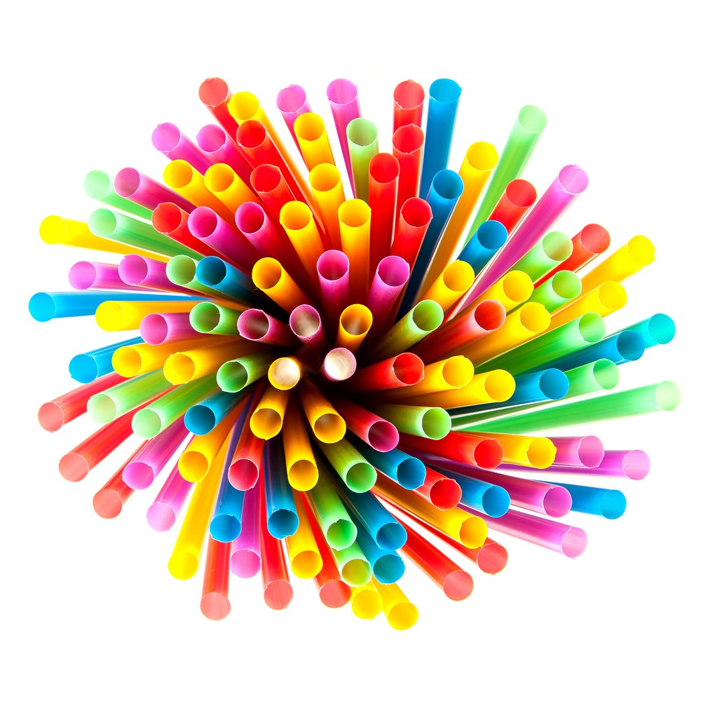
nat5 Design & Manufacture
Plastic - Theory

Slide 2
Learning intentions & success criteria
Learning Intentions
Gain a knowledge and understanding of the properties of plastic.
Gain an understanding of the different types of plastic.
Success Criteria
I can name several properties of plastics.
I can explain the difference between thermoplastics and thermosetting plastics.

Slide 3
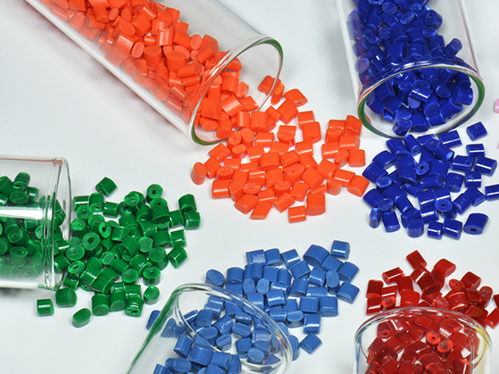
plastics
The basic raw materials used in the manufacture of plastics are oil, natural gas and coal, but contrary to popular belief, plastics are not a new ”space age” material.
Natural plastics such as shellac, wax horn, pitch and bitumen have been known for thousands of years.
Plastics are classified into two main groups;
Thermoplastics
Thermosetting plastics

Slide 4
Plastic properties
Plastics are ideal for mass production of quality products, and can duplicate or better the properties of most other materials, including aluminium, glass, rubber and steel.
General properties of plastics include:
Light weight
Resistance to corrosion
Electrical resistant
Easily formed
Recyclable
Available in various colours

Slide 5
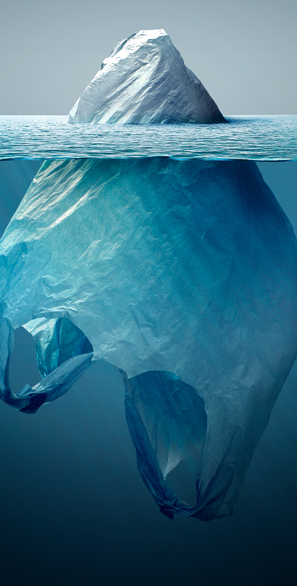
Disadvantages of Plastic
The production of plastics can be very harmful to the environment.
Non-recyclable plastics can be very hard to dispose of safely. They can take many years to decompose and break down

Slide 6
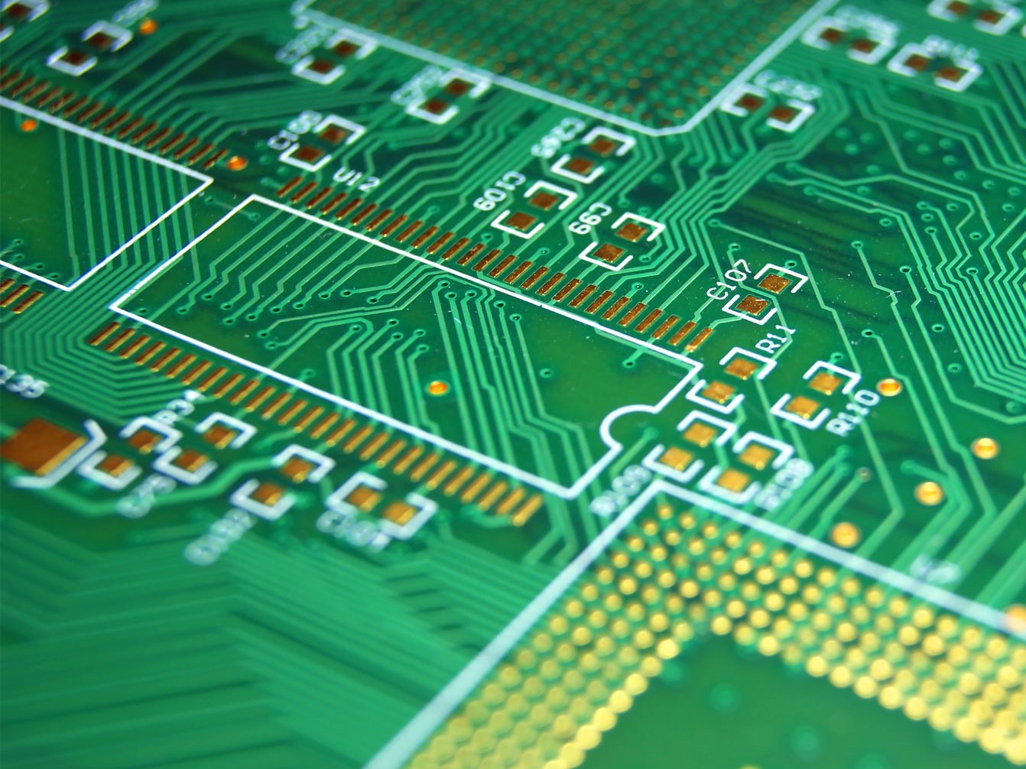
Thermosetting plastics
The molecular structure of thermosetting plastics doesn't allow the molecules to restructure themselves.
This mean the materials can't be reshaped or recycled. Their structure does mean that they are very resistant to heat, electricity, chemicals and scratches.
Because of these properties, thermosetting plastics can be found in products such as electrical fittings and circuit boards.

Slide 7
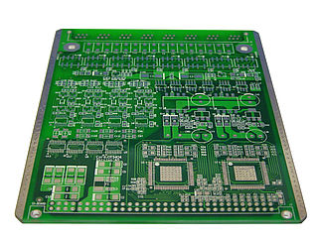
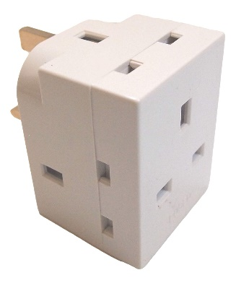
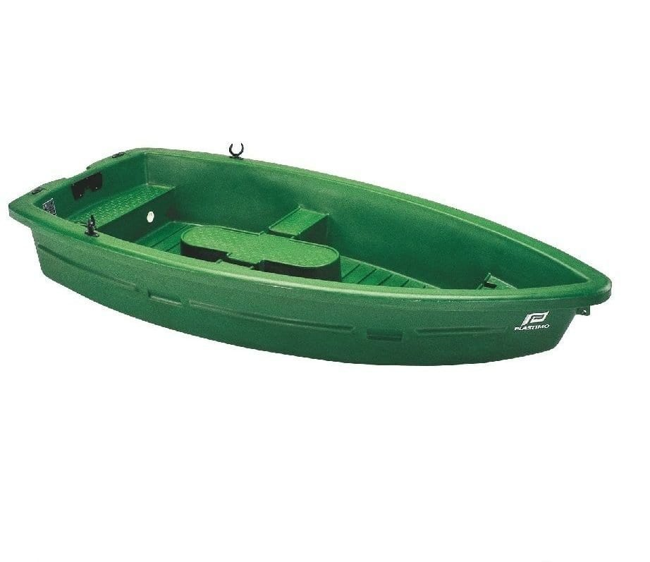
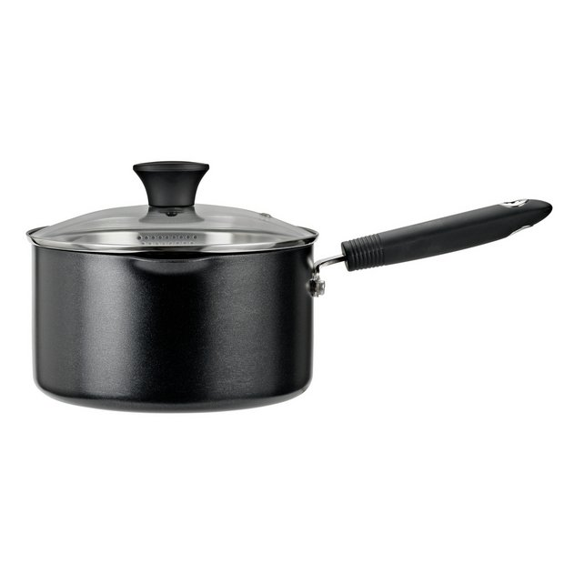
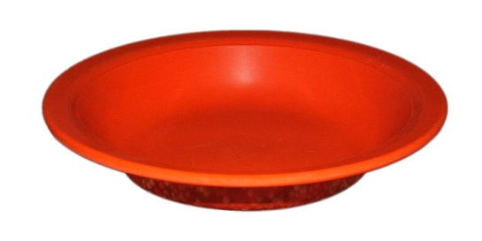
Thermosetting plastics examples
1.
2.
Epoxy Resin (e.g. printed circuit boards, adhesives, bonding).
Urea Formaldehyde (e.g. electrical fittings, handles, control knobs).
Polyester Resin (e.g. car bodies, boats).
Phenol Formaldehyde (e.g. dark coloured electric fittings, bottle tops, kettle handles, saucepan handles).
Melamine Formaldehyde (plywood adhesives, epoxy coatings, cabinet/worktop surfaces).
3.
4.
5.

Slide 8
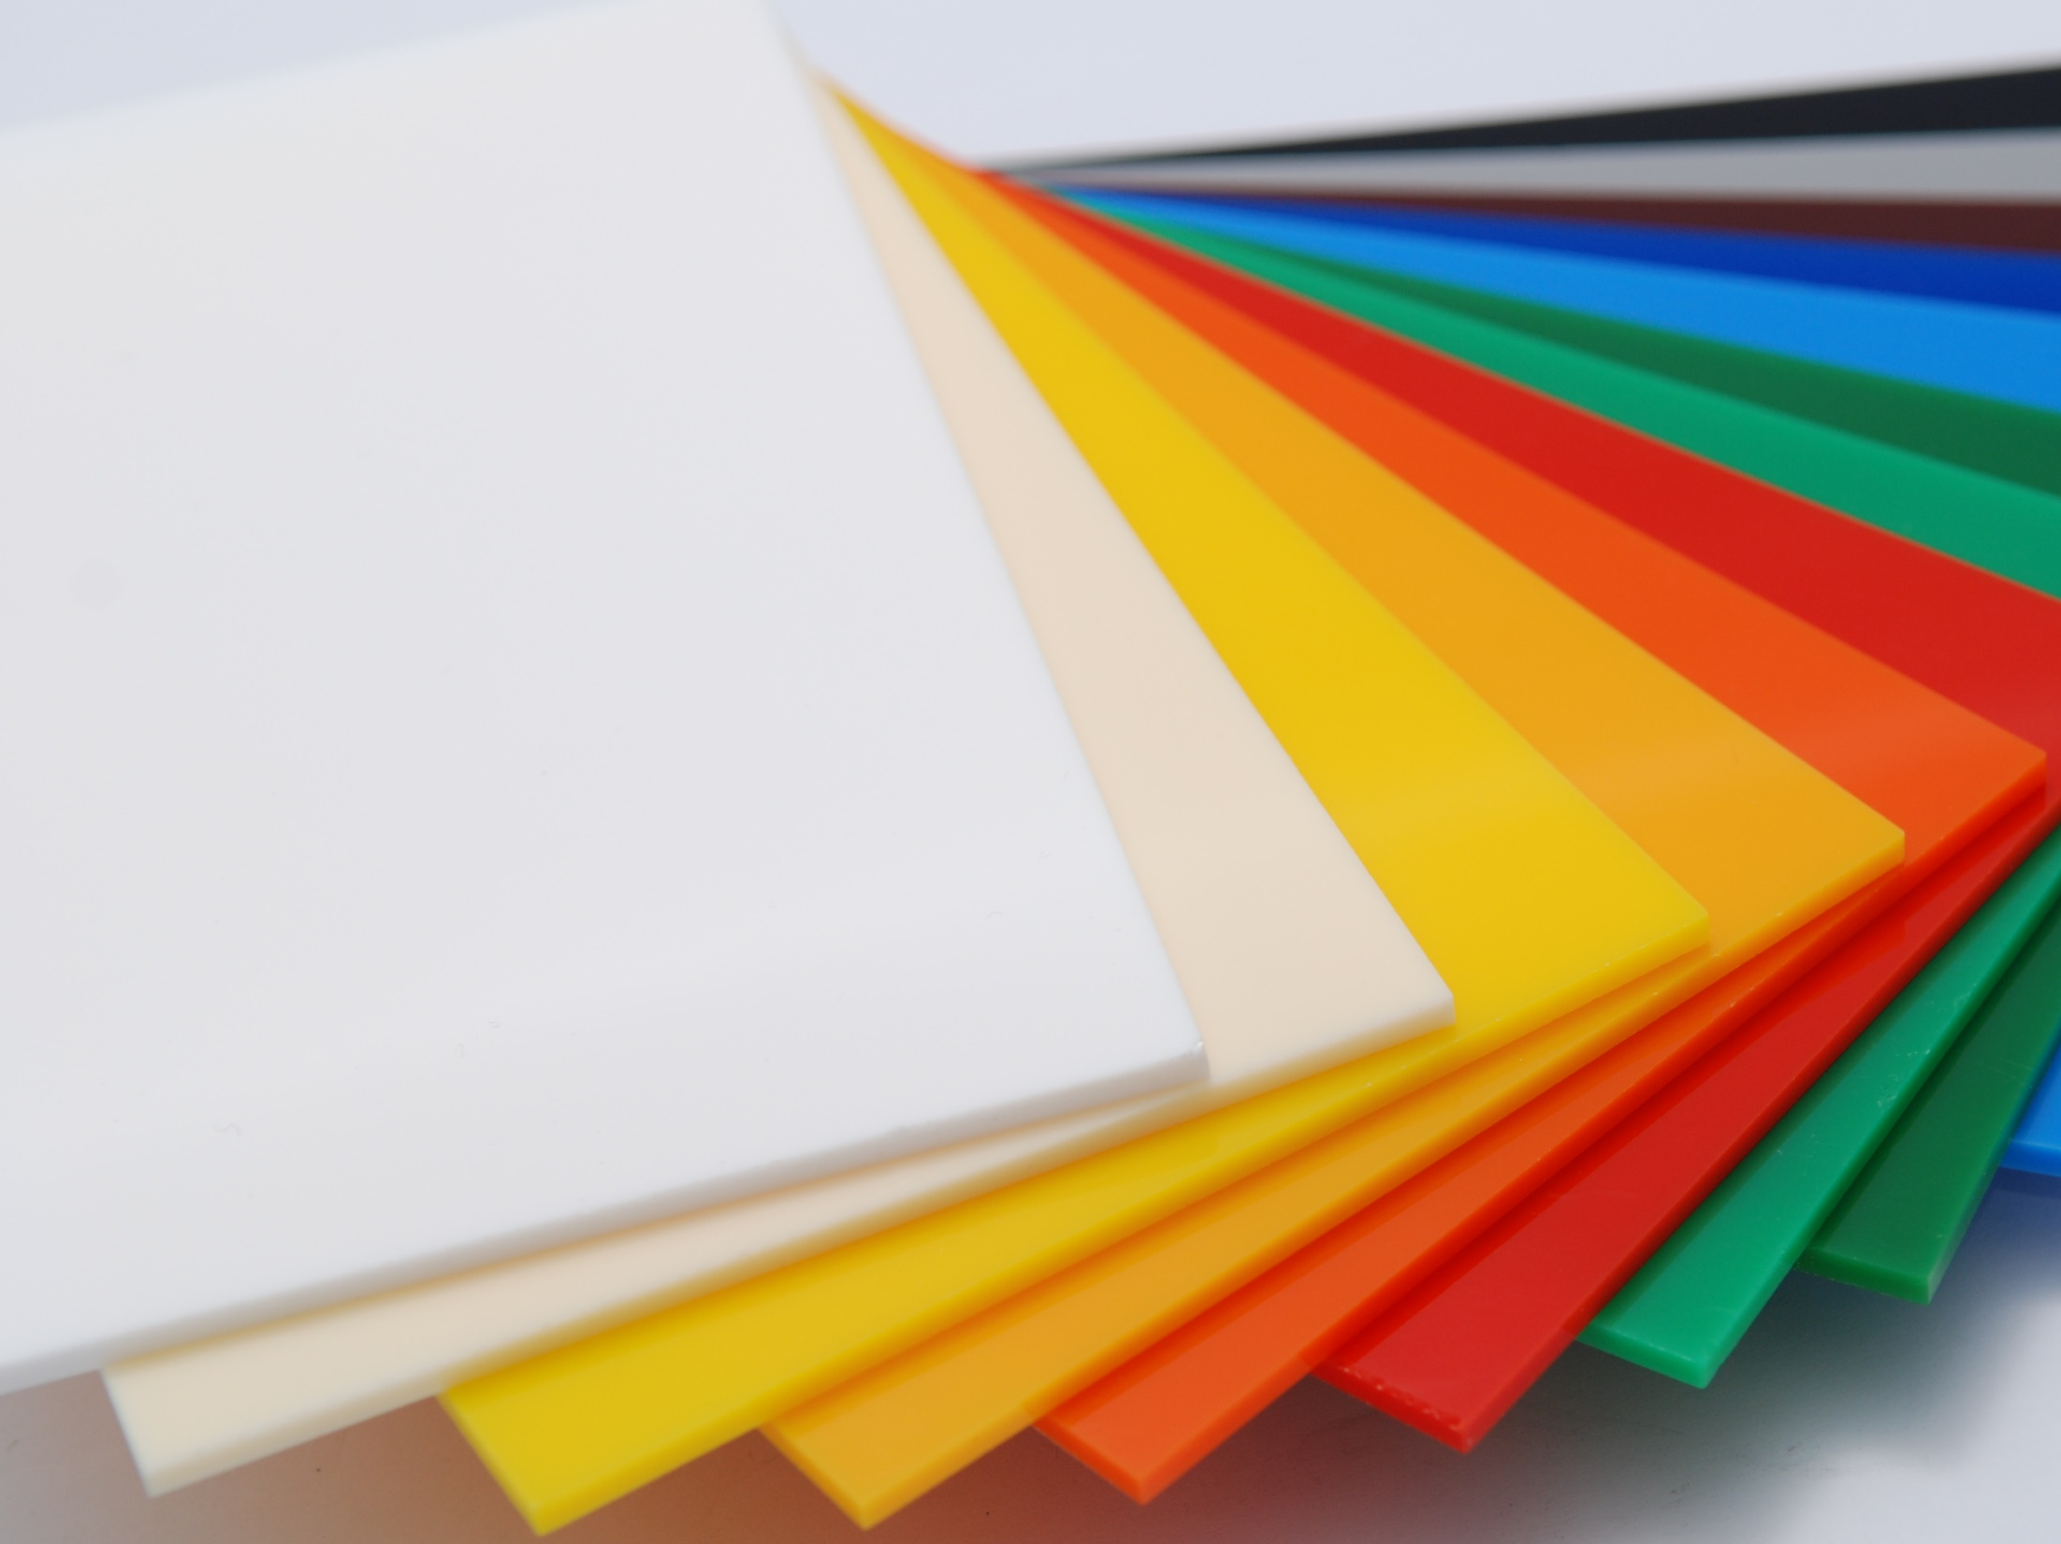
thermoplastics
Thermoplastics soften when heated
Can then be shaped, and then harden as they cool.
With this type of plastic the softening and hardening can be repeated many times over.
When a thermoplastic has been re-heated it will return to it’s original shape unless it has been permanently damaged by excessive heat or deformation.
This characteristic of thermoplastics of re-heating is known as Plastic Memory (i.e. it remembers what its original shape was).

Slide 9
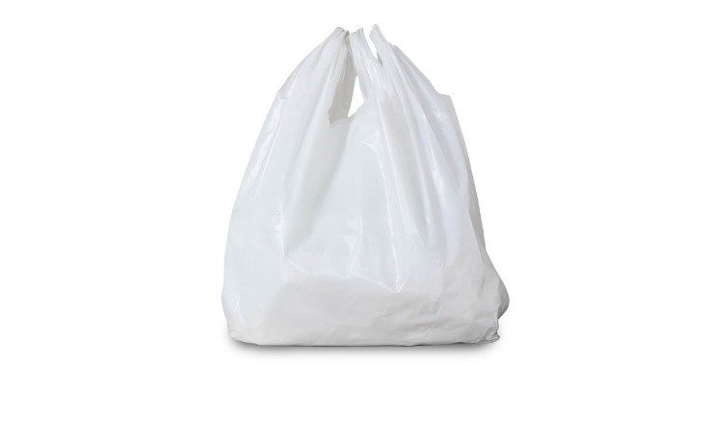
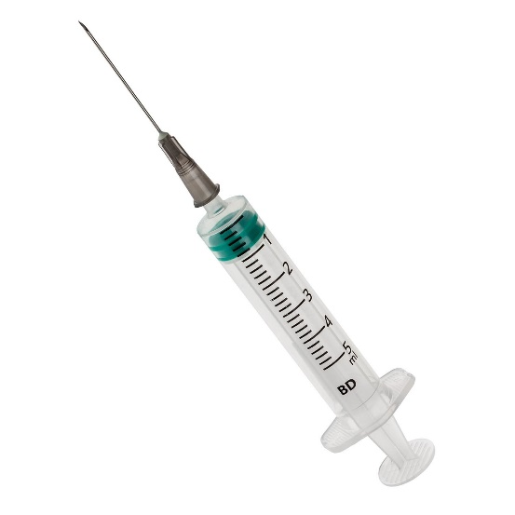
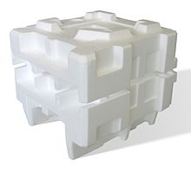
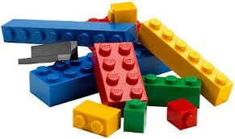
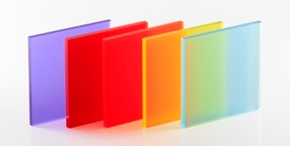
Thermoplastics examples
1.
Polythene (e.g. plastic bags)
Polypropylene (e.g. medical equipment, syringes)
Polystyrene (e.g. packaging)
Polyvinylchloride (e.g. gutters)
Acrylic (e.g. windows, car reflectors)
ABS ((computer keyboards, mice, LEGO bricks).
2.
4.
6.
5.
3.

Slide 10
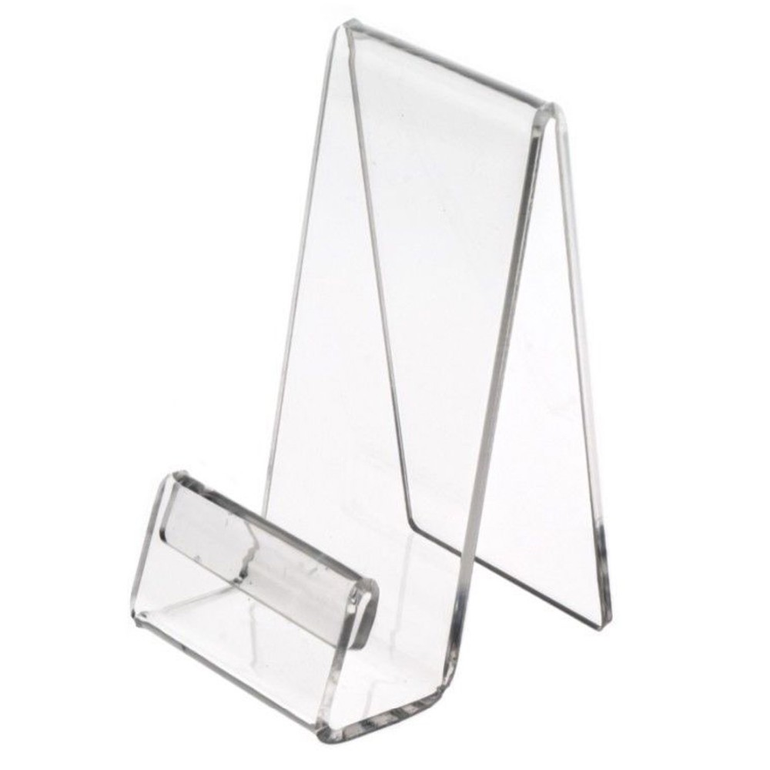
acrylic
In the phone holder project, we will be using different coloured sheets of acrylic, which you will design, cut out and shape into the final product.
Acrylic is a thermoplastic
Properties:
Stiff
Hard
Brittle
Very durable,
Scratches easily
Polishes well
Wide range of colours

Slide 11
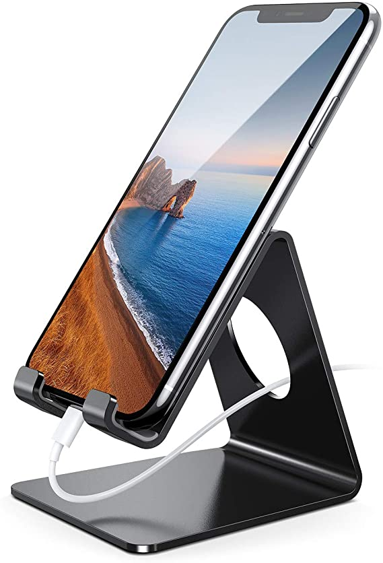
acrylic
We will be using 3mm thick acrylic to make a pencil holder.
We will learn how to:
Mark out on the acrylic
Drill holes in the acrylic
Saw the acrylic
Cross file, draw file, sand and polish the acrylic
Bend the acrylic

